Slide 1

Medical Insurance Premium Prediction
Group No. 7
Mentor – Jatinder Bedi
Group members
Beryl David
Kathyayani Sayana
Priyadharsini
Tharun Prabhakar
Visharad

Slide 2
Agenda
Business Objective
Problem Statement
Data Description and Pre-Processing
Data Preparation
Exploratory Data Analysis & Business Insights
Basic Model
Feature Engineering & Feature Selection
Different Models Information
Comparison & Selection of Model
Further steps and Business impact

Slide 3
Business Objective
Insurance is a policy that eliminates or decreases loss costs occurred by various risks. Various factors influence the cost of insurance.
Health insurance is a necessity nowadays, and almost every individual is linked with a government or private health insurance company.
The medical insurance premiums keep on changing every year due to various factors like medical trends, pharmaceutical trends, and political factor
The goal of this project is to allows a person to get an idea about the necessary amount required according to their own health status

Slide 4
Problem Statement
The ultimate focus is to Predict the Yearly Medical Cover Cost.
Predicting the insurance premiums based on the Medical Condition of the Customers, so that the person can get an idea about the necessary amount required as the premium(according to one’s own health status) and it also helps the insurance companies for the better revenue.

Slide 5
Dataset
Contains 986 rows and 11 columns
Numerical features Age, Height, Weight, Premium Price
Categorical features – Diabetes, BP, Any Transplants, Any Chronic Diseases, Known Allergies, History of Cancer in Family, Number of Major Surgeries
New feature BMI is added for a better model

Slide 6
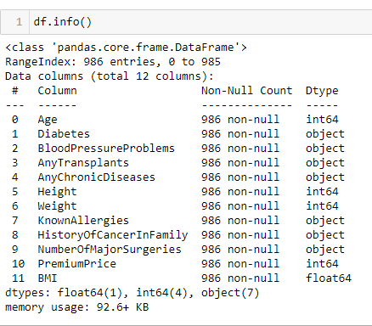
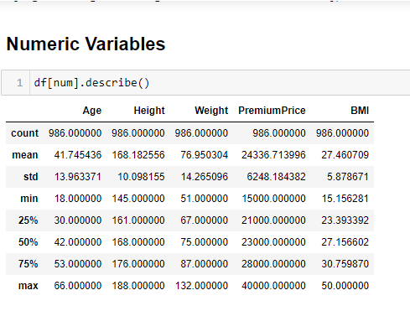
Exploring the Data

Slide 7
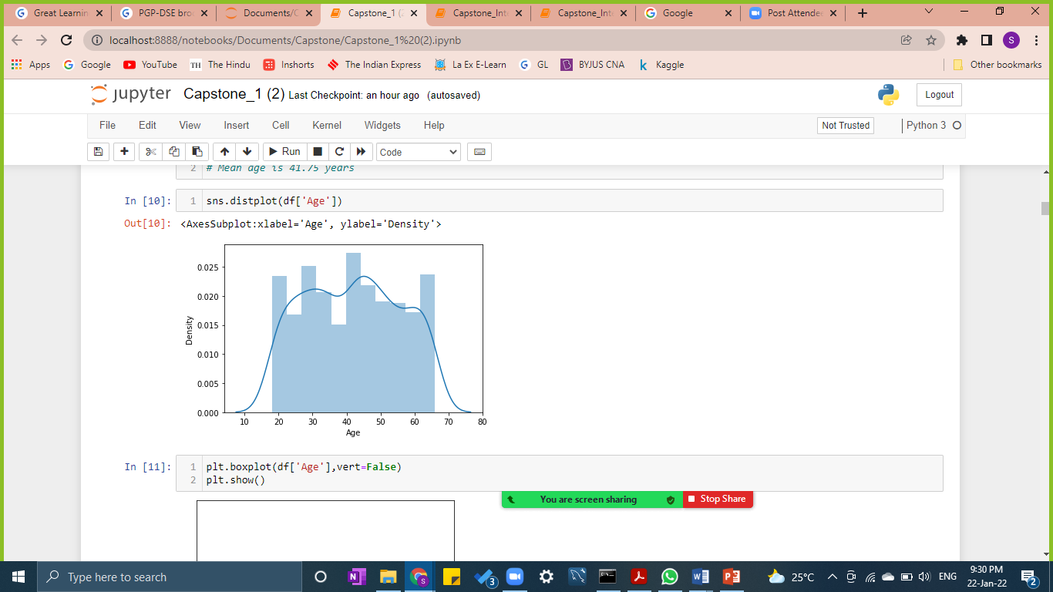
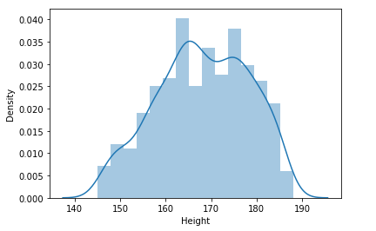
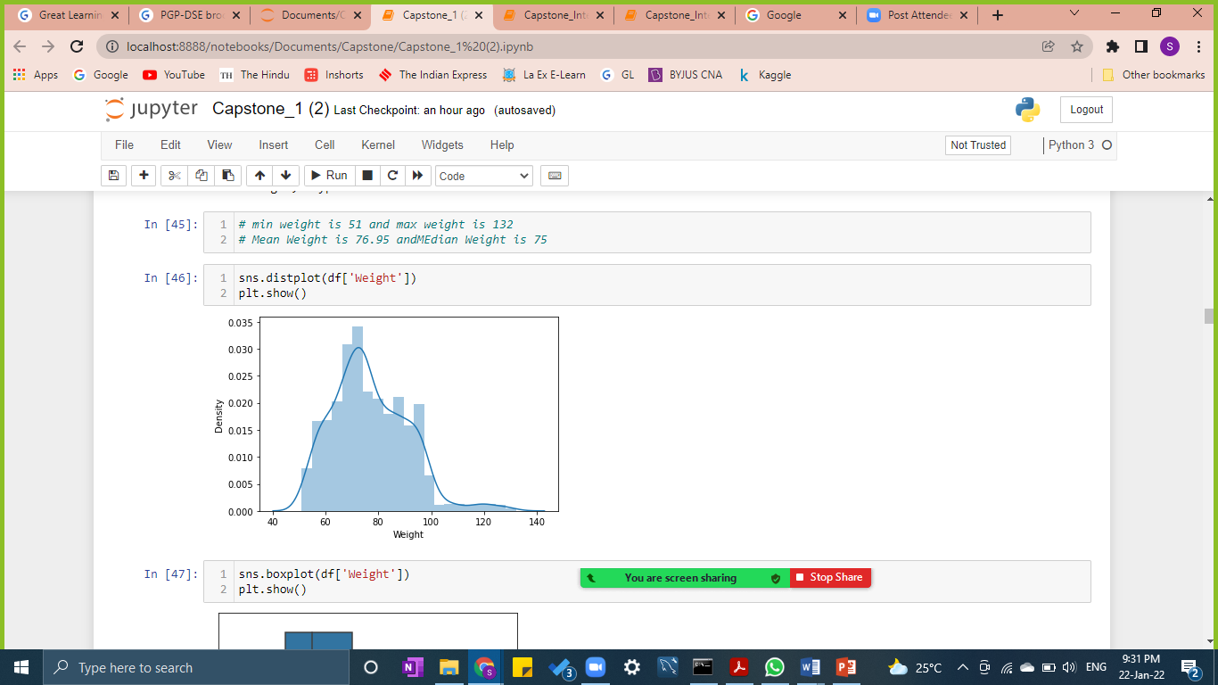
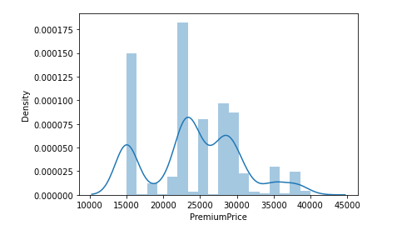
Numerical Data Exploration
Skewness Values –
Age: 0.029
Height: -0.179
Weight: 0.666
Premium Price: 0.097

Slide 8
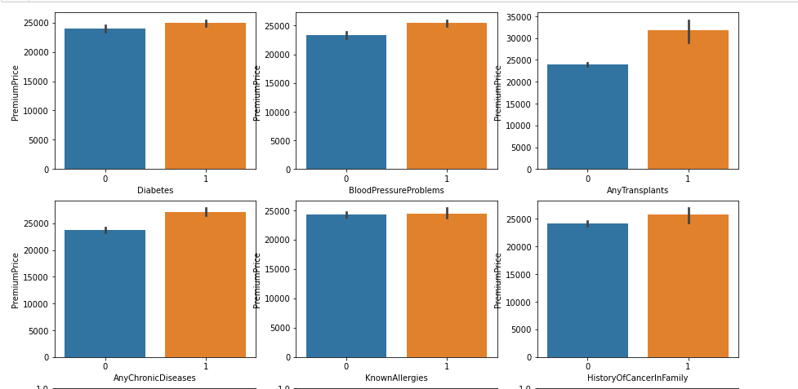
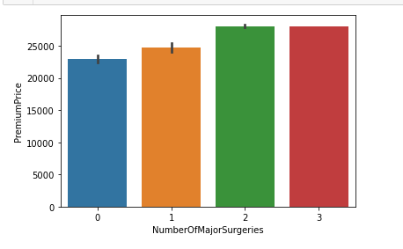
Bivariate Analysis
People with Health Problems such as Diabetes, Blood Pressure, any other Chronic Diseases and any known allergies pay a little more Premium than the people who do not have.
People who had any transplants in the past pay more premium than those who did not.
People with history of cancer in family also pay more premium price than those who do not.
Known Allergies column has no much impact on the Premium Price paid by the customers.

Slide 9
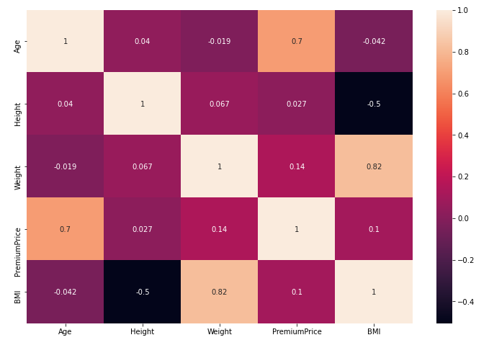
Multivariate Analysis
People with Health problems and having some medical history pay higher premium price
Age is the more significant factor in determining the Premium Price
Also, Chronic Diseases, transplants, Number of major surgeries influence the target variable

Slide 10
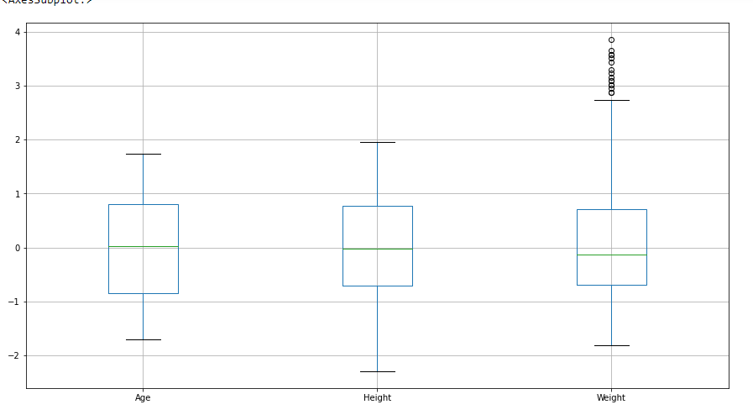
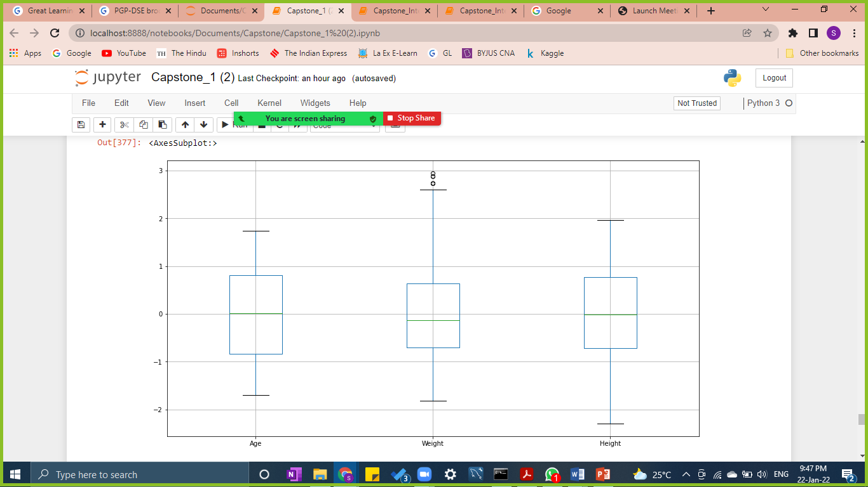
Scaling of Data
Before Outlier Treatment After Outlier Treatment

Slide 11
Base Model
We prepared a base model using OLS Linear Regression.
We used all the variables.
For outlier treatment we use standard scaler.
Insights for base model:
R2 value : Train -> 0.62
MSE: Train->0.38, Test ->0.28
RMSE: Train ->0.62, Test-> 0.53
MAE: Train -> 0.44, Test- > 0.39
Conditional number is 6.53 that mean no multicollinearity in the data.
Train test split is 70:30
Train: 690 rows
Test: 296 rows

Slide 12
Feature Engineering & Feature Selection
Used Selection Technique to find out the best features
Selected Features for final model using forward selection(compared RMSE values):
Age
AnyTransplants
AnyChronicDiseases
Weight
KnownAllergies
HistoryOfCancerInFamily
NumberOfMajorSurgeries
Tuned features by Hyper parameters tuning.
For test models we also bins features { ‘Age’ and ’BMI’}

Slide 13
Different Models Information
We have created total different models
Base Model ( OLS Method)
All the variables
Gradient decent Model
Hyper parameters tuning
Decision Tree Regression
Random Forest Regression
Bin variable AGE
Bin variable BMI
Bin variable AGE and BMI
AdaBoosting
XGBoost
Stacking Regression

Slide 14
Hyper Parameter

Slide 15
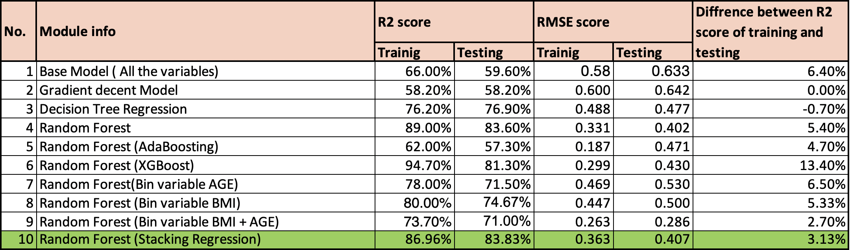
Comparison & Selection of Model

Slide 16
Further steps and Business impact
Collect more data, which will increase the efficiency of Model
Deploy the model to App which will predict the premium price for customer as well as company.
Company can target customers for the selling policy by analyzing features such as Age, Transplants, Chronic Diseases, Weight, Known Allergies History Of Cancer In Family, Number Of Major Surgeries.
Customers can predict the expected premium price they will need.

